Slide 1
RSS Churn Propensity & Covid19 implications
Approach and findings
April, 2020

Slide 2
Table of Contents
Management Summary
Covid19 Implications
Data model
General Features for customer churn modelling
Model results
Path to operationalise
Things to improve
Recommendations

Slide 3
Management Summary
The objective of this project was to develop a churn propensity model, that would enable Elsevier sales & customer relationship teams to intervene before a customer cancels or downgrades their subscription
We followed the industry standard CRISP-DM methodology, which is well suited to handling an iterative model development process
A number of features were developed from the data we received, covering customer characteristics (e.g. industry, size), product characteristics, purchasing history, customer engagement, product usage and other external factors (macroeconomic)
We defined churn in two ways – total churn (i.e. a customer stopping all payments to Elsevier) and partial churn (a customer reducing their payments to Elsevier). In 2018, over $400m in revenue was lost in churn, with this split roughly half and half between partial and total churn (in value terms).
There were some interesting characteristics in the customer groups most predisposed to churn. Reduced usage was a factor, but customers who were not using the product at all were less likely to churn partially than those who had reduced their usage, but not ceased usage entirely.
In developing the propensity model we were able to generate very high levels of predictive power (95%+), but found this to be “overfitting” due to high dimensionality of the data. By reducing the number of features used, we created a model that was still very accurate (87%) that could be used with confidence by the sales team.
We have made a recommendation on how to take this model “into production” so that it can be regularly updated with fresh data, and be used to inform Elsevier sales teams about which customers they should be engaging to mitigate the risk of churn. However, given your current state of capability and capacity, this may take some time to realised
Finally, all the code for this model is documented, with clear instructions to enable Elsevier to manage the model “in life”

Slide 4
Covid19 Implications
Stay Focused. Protect the customer base. Retain Revenues
The Coronavirus-outbreak has rendered the 2020 and 2021 sales forecasts obsolete. All industries have seen their top line plummet except a few such as critical goods, groceries and online collaboration tools.
The old adage of “cash flow is king” couldn’t be more relevant in an economic downturn. Businesses need to prioritise customers and services / products offered during these times to effectively deliver services remotely, retain customers and sustain revenue.
A data driven approach to take stock of
Expected revenue pipeline
Changing customer behaviour
At risk products
Can help business realign their priorities.
The benefits of customer retention are more prominent in an economic downturn. During any downturn loyal customers are the primary, enduring source of much needed cash flow and organic growth. When customers cut down spending, they focus spending on partners they trust
A 5% increase in customer retention increases a firm's profits at a range between 25 and 85 per cent. [HBR]
Acquiring a new customer is 5 to 25 times more expensive than retaining an existing one.[HBR]
The probability of selling to an existing customer is 60-70%, but only 5-20% for a prospect [Invespcro]
Retained customers may purchase in higher volumes than newly acquired customers.
Retained customers are more likely to recommend others to become customers of the firm.

Slide 5
Covid19 Implications
Stay Focused. Protect the customer base. Retain Revenues
Segmenting customers based on their situation and products based on need.
Defining customer persona based on their situation:
Vulnerable: these customers are the hardest hit financially and they will reduce all types of spending
Troubled but resilient: These customers have seen a material decline in finances, but have wide range of income levels and can hold on to weather the downturn.
Comfortable but cautious: These customers feel financially secure and are cautiously optimistic about their ability to ride out the current downturn.
Surging: These customers are doing well during the downturn and have seen their business grow and are looking for resources to keep up with the growth. Eg: FMCG retailers, online collaboration tools.
Needs based classification of products:
Essentials: These goods and/or services are necessary for survival and essential for the business to keep lights on.
Deferrable: These goods are needed to run the business, but can be reasonably postponed till later.
Dispensable: These are good and or services that are perceived as unnecessary or not justified.
Indulgence: These are goods that can be considered luxury items, whose purchase can be justified if purchased at a discount
Adapting HBR’s 2009 recession behaviour segments to COVID19 churn implications

Slide 6
Covid19 Implications
Stay Focused. Protect the customer base. Retain Revenues
Protecting revenue by prioritizing at risk products
Businesses will need to take stock of inventory of expected revenue and products at risk.
Revenue from contractual subscriptions can be considered secure.
But revenue expected from commitments, but no contracts will be at risk.
Revenue from one-off products will take a significant hit in the vulnerable and pained customers segments.
Assess the revenues from products you had expected this year and sort them into simple categories.
When analyzing products also consider competitor alternatives as they will be prime candidate for switching during down turn. Significant market share shift often occur during downturns.

Slide 7
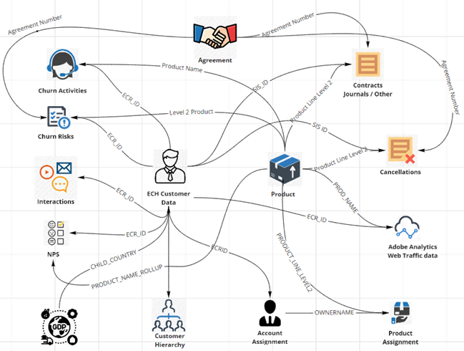
Data model
Data mapping and data ownership established
In a Machine Learning project like this one, understanding the business and data is paramount to producing a model that delivers tangible business value.
File | Data Owner
191224_churn_risks_V02 | Anton Jumelet
191212_churn_activities | Anton Jumelet
interaction | Georgia Durston
DataCR_from_2015_Cancellations | Joanna Aksiuto
DataCR_from_2015_journals | Joanna Aksiuto
DataCR_from_2015_other_products | Joanna Aksiuto
ECH Customer Data | Marc Hansen
NPS_Cleansed_Data | Georgia Durston
Hierarchy Data | Artur
GEDR, Data | Joanna
Web Traffic Data | Harry Wilkes
SD Usage Data | Harry Wilkes / Artur
Account Assignment | Anton
Product Assignment | Anton
Upon landing, we had a series of meetings with the business to understand the data sources provided to us, as well as their position in the wider business context.
We created a data model map to visually represent the data considered in the model
Detailed diagram: https://confluence.cbsels.com/pages/editpage.action?pageId=141573820

Slide 8
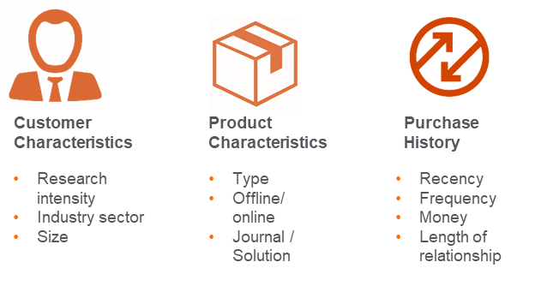
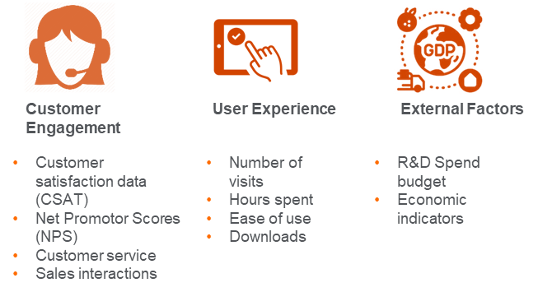
Features for model development
Building on experience and expertise to identify features for subscription churn
Features for customer churn propensity
Feature engineering is the most important phase of model development as these are the predictors that will help you to develop the model.
Based on literature review and previous experience in subscription churn and publishing businesses we had identified features broadly in the 6 classes depicted in the diagram on the left.
Also to gain understanding from the business and sales reps, we conducted a qualitative workshop to get their first hand experience on the factors that might be indicators of customer churn.
We have made the feature engineering process easy to follow and reproducible so that in future, new features can be engineering using same or similar code

Slide 9
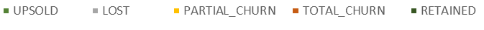
Definition of churn - overall
The value lost to churn has been increasing over the years, the % of customers upsold remains consistent and over half of bookings come from these customers
Distribution of customers x product by churn / no churn type
Definition of churn
As we started the project the definition of churn was the cancellation of an agreement. However during our workshop feedback from business suggested that subscription cancellation does not always constitute churn as customers are often upsold on a different subscription, thus triggering cancellation of existing subscription
We define churn into two categories
Total churn: when the customer value for a product goes down to zero or lower that zero.
Partial churn: when the customer value is more than zero for a product but is lower than in the previous year.
Here we consider churn at product line level 2. thus a customer might have no churn on a journal product but total churn on SCOPUS and partial churn on Reaxys.
Distribution of value lost by churn type

Slide 10
Partial churn range - overall
Customers that churn partially churn, ~40% of these customers lose value in the range 40-50% and this is consistent over the years
Distribution of partial churn customers by % of value lost
Distribution of partial churn customers
Here we distribute the partial churn customers into categories to determine the size of impact of partial churn.
We see the in 2018 28% of customers that partially churned lost value in the rage 40-50% compared to previous year
The second largest chunk of 11% is 10-20% value lost over last year.
However the third largest category of 10% is partial churn of over 80% value lost. These customers are very close to total churn.
The distribution is fairly consistent over the 3 year period, with the top two categories remaining unchanged.
2018
2017
2016

Slide 11
Customer trend before churn - overall
Over two thirds of the value lost was from customers that were upsold in the last two years.
Customer bookings trend
Customer Trend towards churn
Here we see the 3 year trend of customers before they churned either totally or partially.
4% of customers churned partially on a given product after they were being upsold for last two years. These customers represent 38% of the total value lost in 2018
5% of customers churned totally on a given product after being upsold for last two years, these customers represent 30% of the total value lost.
About 2/3rd of value that you lose from customers that have been upsold in the last two years.
% of total cust
% of value lost
Trend 2015-2018
UPSOLD-UPSOLD-PARTIAL_CHURN | 4% | 38%
UPSOLD-UPSOLD-TOTAL_CHURN | 5% | 30%
PARTIAL_CHURN-UPSOLD-TOTAL_CHURN | 1% | 6%
UPSOLD-PARTIAL_CHURN-TOTAL_CHURN | 1% | 5%
PARTIAL_CHURN-UPSOLD-PARTIAL_CHURN | 1% | 5%
LOST-UPSOLD-TOTAL_CHURN | 4% | 5%
UPSOLD-PARTIAL_CHURN-PARTIAL_CHURN | 1% | 3%

Slide 12
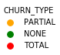
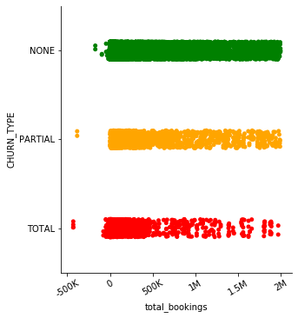
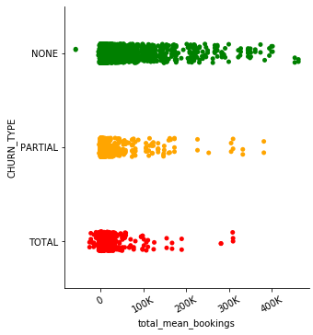
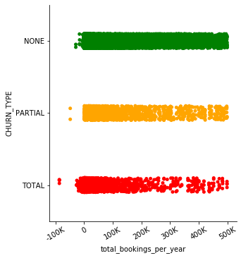
Churn by bookings value
Low value customers are highly likely to churn totally,
Total churn is dense for customers with total bookings value (customer total value over the period 2015-2018) less than $ 500,000
whereas partial churn is well spread out over the range
Total churn is dense for customers with total mean bookings value (mean contract value) of
$ 50,000
And partial churn is dense for total mean bookings value less than 200,000
Total churn is dense for customers with bookings per year value (total customer value per year) of $ 100,000
And partial churn is well spread out over the range

Slide 13
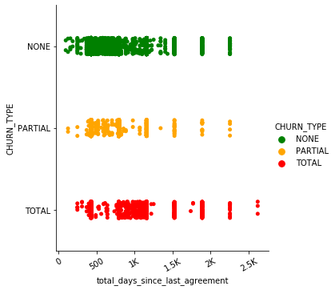
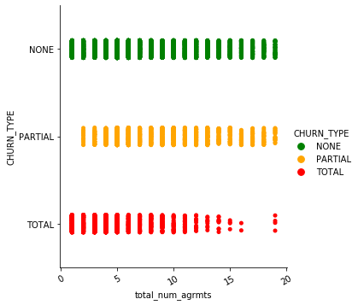
Churn by Recency and number of agreements
Customers that have not been engaged since long and customers with fewer agreements in their lifetime are more likely to total churn
Total churn is dense for customers where the days since last agreement is in between ~750 to ~1200 days
Total churn is more prevalent in customers with number of agreements fewer than 10.

Slide 14
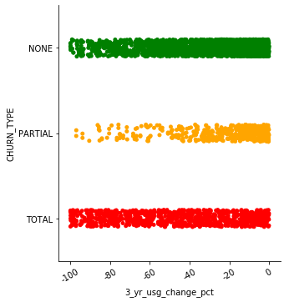
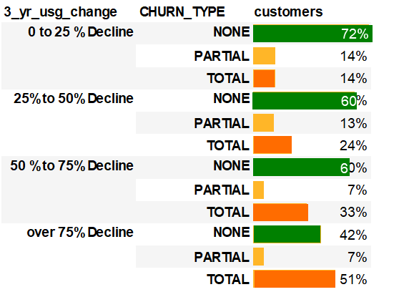
Churn by Journals Science Direct Usage
Opposing trends in partial and total churn as usage declines
Total churn by Journals Science Direct Usage
Partial churn is more prevalent when the journals usage decline is in the range 0% to 40%
When the usage decline is more than 40%, partial churn is rarefied
Percentage of customers that churn partially reduces as usage declines whereas percentage of customers that churn totally increases with decline in usage
Whereas when the usage has declined by more than 40% percent, users are not actively using the product but not concerned about cancelling the subscription.
When usage has declined in the rage 0 to 40% customers are more likely to churn partially.
Partial churn is more prevalent when the usage decline is less than 40%

Slide 15
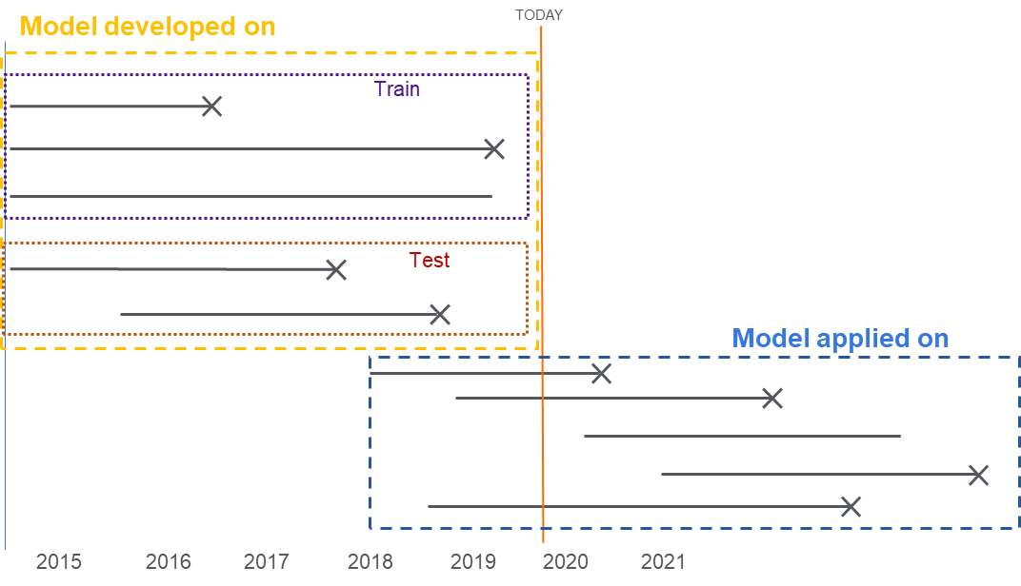
Model development and application
Extracted data can be split into Development set and target set using the model notebooks
Data split into development and target sets
Data for model development and target
Data for model development and model application is exported from source systems for a period of 5 years 2015-2020
Subscriptions follow an annual cycle with a sub start date and a sub end date.
We want to build a model that takes into consideration customers history over the past years to make a prediction for the current cycle. i.e. subscriptions with start date 2019 or 2020.
We set aside these active subscriptions as target dataset subs with start-date and end date after TODAY. These subscriptions will start TODAY or after and end in 2019 / 2020 / 2021
And we use the non-active subscriptions with sub end date before TODAY as our development dataset. These subscriptions will have start date in 2015/16/17/18 and end date in 2015/16/17/18/19.

Slide 16
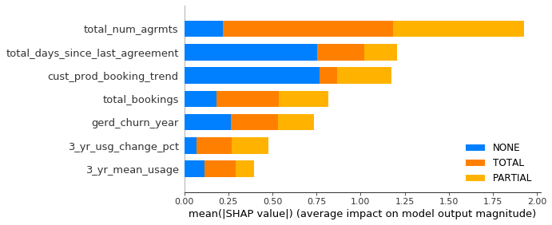
Simplified model results - Journals
Simplified dimension model after tuning hyperparameters give a model that is generalised
Simplified model feature importance
Simplified model – a more generalised model
This model has an accuracy of 87% even with just 7 features.
The model is much more simplified and we haven’t lost a significant accuracy and this model is a more generalised without overfitting the data
As we can see in the confusion matrix, the model does well at classifying churn class (TOTAL and PARTIAL)
Where it exhibits small increase error in NONE churn

Slide 17
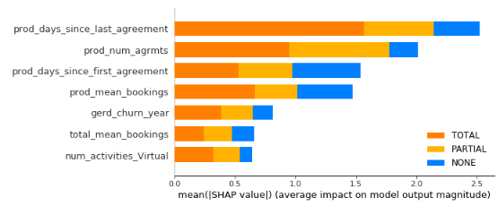
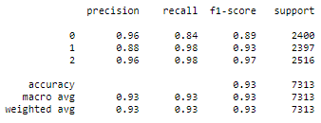
Simplified model results - Solutions
Simplified dimension model after tuning hyperparameters give a model that is generalised
Simplified model feature importance
Simplified model – a more generalised model
This model has an accuracy of 93% even with just 7 features.
The model is much more simplified and we haven’t lost a significant accuracy and this model is a more generalised without overfitting the data
As we can see in the confusion matrix, the model does well at classifying churn class (TOTAL and PARTIAL)
Where it exhibits small increase error in NONE churn

Slide 18
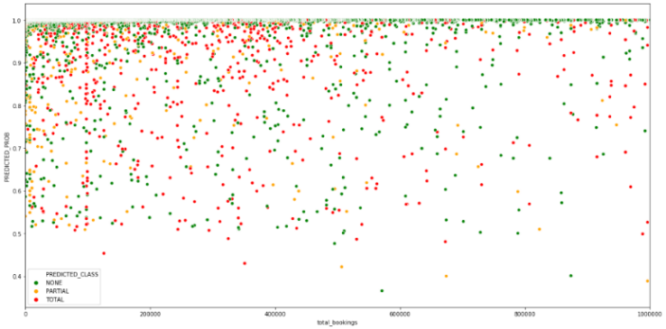
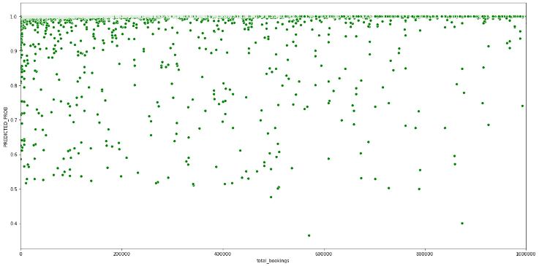
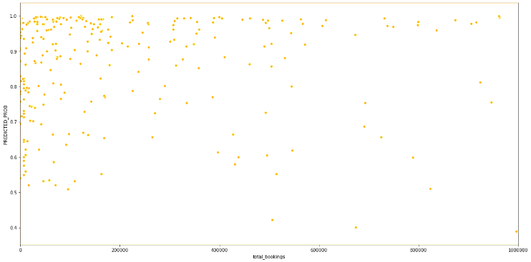
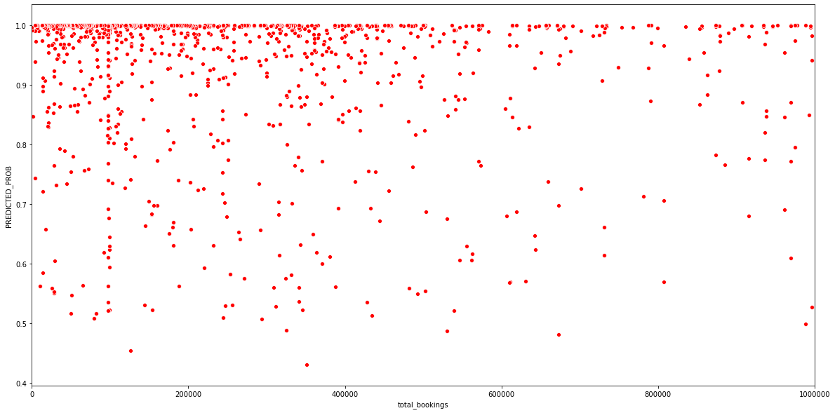
Churn propensity by customer value - Journals
Classifying customers into high, medium, low priority to operationalise
Increasing probability →
Increasing probability →
ALL
NO CHURN
Increasing Bookings →
Increasing Bookings →
Med Priority
Med Priority
High Priority
Increasing probability →
Increasing probability →
Low Priority
Med Priority
Low Priority
PARTIAL CHURN
Increasing Bookings →
Increasing Bookings →
TOTAL

Slide 19
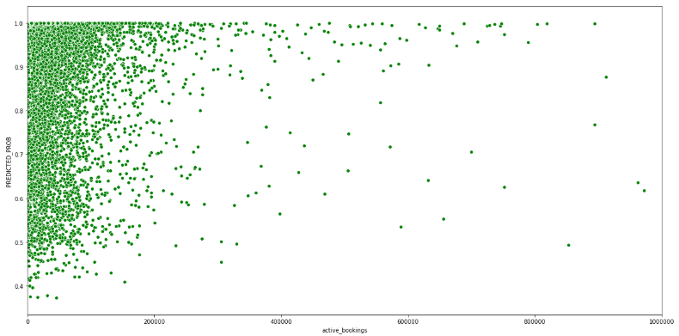
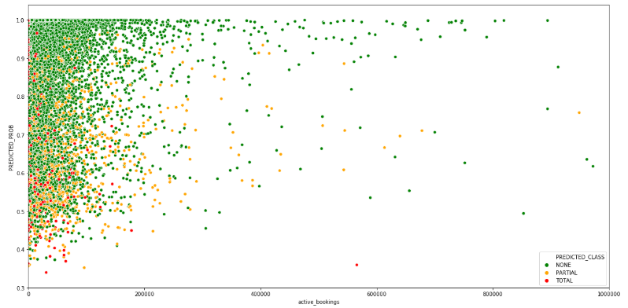
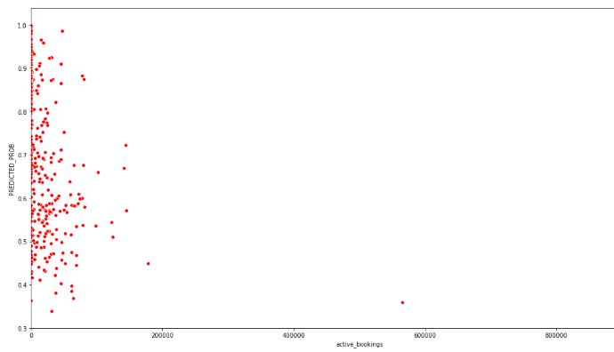
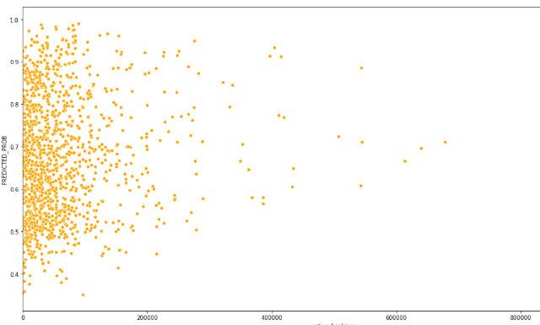
Churn propensity by customer value - Solutions
Classifying customers into high, medium, low priority to operationalise
Increasing probability →
Increasing probability →
ALL
NO CHURN
Increasing Bookings →
Increasing Bookings →
Med Priority
Med Priority
High Priority
Increasing probability →
Increasing probability →
Low Priority
Med Priority
Low Priority
PARTIAL CHURN
Increasing Bookings →
Increasing Bookings →
TOTAL

Slide 20
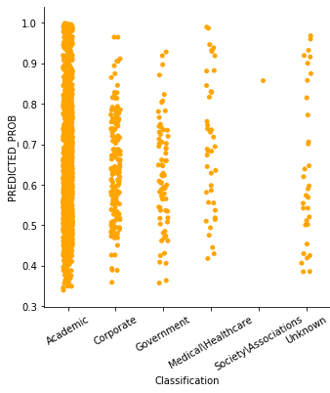
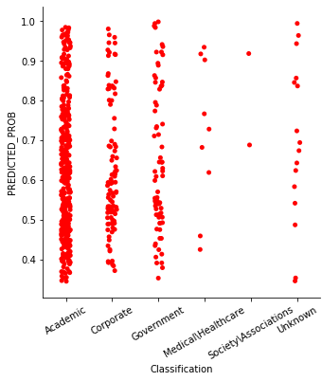
Churn by industry classification
Academics exhibit higher partial churn whereas corporate and government customers exhibit higher total churn
Partial churn is higher in Academic institutions at 80% even though they are 69% of the customer base. Whereas total churn is higher in Government at 14% even though they represent 8% of customers
Churn Industry % Cust x Prod

Slide 21
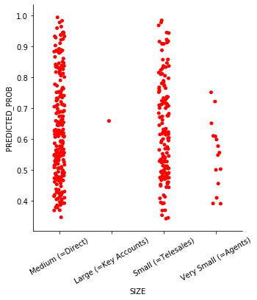
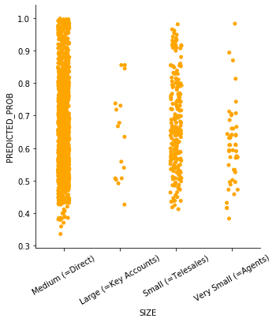
Churn by organisation size classification
Large organisations are more like to stay
Churn Org size % Cust x Prod
Total churn is more prevalent in Small organisations at 37% even though they are ~20% of business

Slide 22
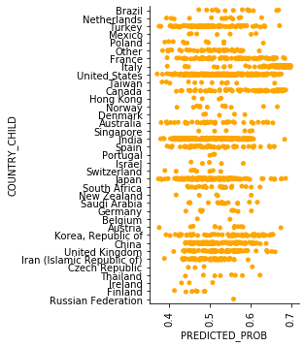
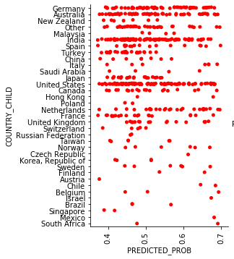
Churn by regions
Customers in Germany and Australia have experienced higher rate of total churn whereas customers in Turkey and Italy have experienced higher partial churn
Churn Region % Cust x Prod
Partial churn is more prevalent in Italy Turkey and France
Total churn is more prevalent Germany, Australia.

Slide 23
Building path to production

Slide 24
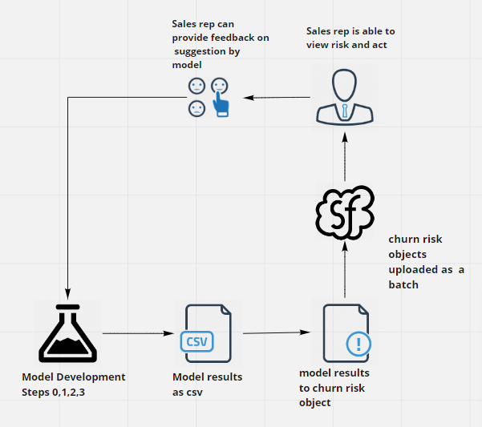
Operationalise model results into actions
(Minimum Viable Product) MVP Operational proposal
We propose a MVP solution to operationalise the model into sales force
Run the model steps 0,1,2,3
These steps will ingest data, split into dev and target sets
Develop the models on dev dataset and save the model to disk
Developed model is then applied to target dataset and results csv are saved to disk
Model results are collected and formatted into the (Salesforce Modernization) SFM batch load template for churn risks object.
These churn risks objects could then be loaded into SFM as a one-off.
The same engagement with the SFM stakeholders and RSS business would be required to both obtain access and define the business rules of what risks can be created.
Once risks are uploaded into Salesforce, the churn risk and class are any other features can be made available as a churn risk on an account.
Sales reps owning an account the view the risks and add feedback and /or take action
After a quarter or specific period, data of churn risks can be exported and compared with account status to verify if risk was realised. In effect testing the model in operation

Slide 25
Things to improve
Availability of data: ideally data sets would be available at the start of the project so that team can spend more time on feature engineering and model tuning and results preparation.
Availability of tools: Dealing with large datasets such as Usage data, we would quite often run into memory issues on the laptop, having tools such as Databricks can be leveraged to work with larger datasets.
Deployment of model: while the model is developed, deploying the model is a challenge given the lack of existing processes to take models to production, it is imperative to establish an model productionisation solution an process.
Logging Accurate data: Sales representative can be encouraged to log correct and complete data on sales force as these can provide insights and features towards model development
Product Level: The current model has been constructed at product level 2. especially for products such as Journals, it would be good exercise to build a model at Product level 3 giving better insights to Sales representatives.
Specific Prod Group / Country: The current model is a global model taking into consideration all products and all geographies, it would be good to also develop models at specific countries and for specific product as the characteristics of these specific geographies and / or product might provide better insights into customer retention.

Slide 26
Top 50 ordered customer likely to churn
List of customer and product combinations ordered by a composite score of churn type, probability to churn and Active value today.
ecrid | name | Product Line Level 2 | PREDICTED_CLASS | PREDICTED_PROB | active_bookings
ECR-310775 | Coordination of Higher Education Personnel Improvement | Journals Electronic Subscriptions | PARTIAL | 93% | 31735189
ECR-380603 | Collaboration of the Dutch university libraries and the Koninklijke Bibliotheek | Journals Electronic Subscriptions | PARTIAL | 85% | 14389240
ECR-566584 | Turkish Academic Network and Information Centre National Electronic Resources Academic Licence | Journals Electronic Subscriptions | PARTIAL | 54% | 16123729
ECR-373436 | Consortium Polish Academics | Journals Electronic Subscriptions | PARTIAL | 67% | 7666827
ECR-338041 | Hellenic Academic Libraries Link | Journals Electronic Subscriptions | PARTIAL | 75% | 4862298
ECR-928880 | Centre for Research On Scientific and Technical Information | Journals Electronic Subscriptions | PARTIAL | 84% | 4303175
ECR-1771 | Monash University | Journals Electronic Subscriptions | TOTAL | 97% | 1780105
ECR-371055 | National Agency of Science and Technology Information | Journals Electronic Subscriptions | TOTAL | 74% | 1908000
ECR-1765 | Australian National University | Journals Electronic Subscriptions | TOTAL | 89% | 1535879
ECR-52459 | University of Texas at Austin | Journals Electronic Subscriptions | PARTIAL | 88% | 2705886
ECR-2329 | Curtin University | Journals Electronic Subscriptions | TOTAL | 93% | 1268459
ECR-796 | Mississippi State University | Journals Electronic Subscriptions | PARTIAL | 66% | 3370713
ECR-1822 | National University of Singapore | Journals Electronic Subscriptions | PARTIAL | 81% | 2730744
ECR-1784 | University of New South Wales | Journals Electronic Subscriptions | PARTIAL | 68% | 3025478
ECR-310775 | Coordination of Higher Education Personnel Improvement | Journal Level Sales | PARTIAL | 94% | 2090761
ECR-2386 | Macquarie University | Journals Electronic Subscriptions | TOTAL | 91% | 1080945
ECR-2381 | Queensland University of Technology | Journals Electronic Subscriptions | TOTAL | 93% | 994734.4
ECR-2131 | University of Bologna | Journals Electronic Subscriptions | PARTIAL | 95% | 1925522
ECR-875 | Oklahoma State University Stillwater | Journals Electronic Subscriptions | PARTIAL | 76% | 2366522
ECR-2402 | The University of Newcastle | Journals Electronic Subscriptions | TOTAL | 90% | 996444.3
ECR-1775 | The University of Western Australia | Journals Electronic Subscriptions | TOTAL | 66% | 1348887
ECR-523603 | Higher Education Commission Pakistan | Journals Electronic Subscriptions | PARTIAL | 72% | 2431883
ECR-573664 | Clarivate Analytics Inc | Journals Electronic Subscriptions | PARTIAL | 53% | 3260000
ECR-2621 | USDA-ARS Beltsville Agricultural Research Center | Journals Electronic Subscriptions | PARTIAL | 66% | 2631090
ECR-1206 | Washington University in Saint Louis | Journals Electronic Subscriptions | PARTIAL | 73% | 2350756
ECR-81881 | RMIT University | Journals Electronic Subscriptions | TOTAL | 92% | 940882.2
ECR-2372 | Griffith University | Journals Electronic Subscriptions | TOTAL | 98% | 873227.6
ECR-1198 | Vanderbilt University | Journals Electronic Subscriptions | PARTIAL | 76% | 2245404
ECR-1120 | University of Pittsburgh | Journals Electronic Subscriptions | PARTIAL | 68% | 2433297
ECR-1103 | University of North Carolina at Chapel Hill | Journals Electronic Subscriptions | PARTIAL | 63% | 2534321
ECR-2159 | University of Rome La Sapienza | Journals Electronic Subscriptions | PARTIAL | 99% | 1602489
ECR-2062 | University of Milan | Journals Electronic Subscriptions | PARTIAL | 93% | 1708767
ECR-1780 | The University of Adelaide | Journals Electronic Subscriptions | TOTAL | 65% | 1218022
ECR-848 | New York University | Journals Electronic Subscriptions | PARTIAL | 69% | 2263072
ECR-2384 | James Cook University | Journals Electronic Subscriptions | TOTAL | 89% | 876894.1
ECR-1029 | University of Delaware | Journals Electronic Subscriptions | PARTIAL | 74% | 2115581
ECR-2147 | University of Padua | Journals Electronic Subscriptions | PARTIAL | 92% | 1687325
ECR-2369 | Flinders University | Journals Electronic Subscriptions | TOTAL | 81% | 961715
ECR-1786 | University of Queensland | Journals Electronic Subscriptions | PARTIAL | 63% | 2378054
ECR-1973 | Massey University | Journals Electronic Subscriptions | TOTAL | 61% | 1208457
ECR-948 | Texas Christian University | Journals Electronic Subscriptions | PARTIAL | 82% | 1783642
ECR-61997 | University of Wisconsin-Madison | Journals Electronic Subscriptions | PARTIAL | 68% | 2135913
ECR-1302 | York University | Journals Electronic Subscriptions | PARTIAL | 86% | 1650755
ECR-1092 | Nevada System of Higher Education | Journals Electronic Subscriptions | TOTAL | 77% | 899036
ECR-2363 | Deakin University | Journals Electronic Subscriptions | TOTAL | 97% | 693791.5
ECR-1268 | University of Calgary | Journals Electronic Subscriptions | PARTIAL | 88% | 1506520
ECR-1260 | University of Montreal | Journals Electronic Subscriptions | PARTIAL | 83% | 1592757
ECR-2407 | Western Sydney University | Journals Electronic Subscriptions | TOTAL | 83% | 769984.9
ECR-2082 | National Research Council | Journals Electronic Subscriptions | PARTIAL | 99% | 1289977

Slide 27
Next Best Action
Remodel the churn propensity to model customer behaviour in the new normal.
Customer Segmentation based on impact of downturn and customer behaviour
Product segmentation based on need and competitor alternatives available in the market
Identifying sources of secure revenue and at risk revenue.
Data sources:
Customer demographics (Industry, size)
Customer financial health (Revenue, profitability, debt)
National Covid19 impact (cases, deaths)
National GDP and R&D Spend data
Sales inputs on competitor products
NPS data.
Sales inputs on product perceived value
Competitor alternatives
Product holding data
Churn history / Transaction History
Usage dat
Some of this data we have already used in churn project, the green line items are the new datasets that can be used.

Slide 28
Addendum

Slide 30

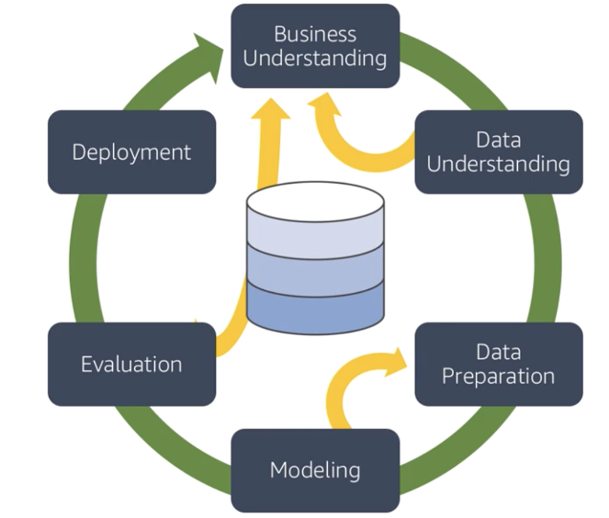

Process Delivery and Process
Industry standard processes adopted while being agile
CRISP-DM methodology
CRISP-DM methodology
We structured the project on the CRISP-DM methodology
CRISP-DM stands for cross-industry process for data mining. The CRISP-DM methodology provides a structured approach to planning a data mining project.
Although we have leveraged the CRISP-DM methodology to structure the project. To ensure that we can accommodate the vagaries of project, we also employed agile practices such as sprints, daily stand-ups, sprint demos and Kanban that helped us to adopt an iterative process and drive team engagement.
We have had multiple workshops with Data & Analytics team, Sales enablement teams and Sales representatives to capture their feedback.
Workshop with D&A and sales enablement team
workshop with BTS
Workshops with Data owners
Iterative process to ingest new and late received data
iterative
Workshop with D&A and sales enablement teams
Iterative and repeatable process

Slide 31










Tools leveraged
Leveraging tools to drive collaboration and easy work shareability and maintenance.
Set Up Repository
Set Up Virtual Environment
Agile Tools
To execute project in an effective agile manner and track progress and improve visibility to stakeholders, we leveraged tools such as JIRA Kanban, Confluence and Miro.
To enable collaboration and effectively manage code we setup GitLab repository. With a git repository future replication and branching can be done easily and multiple versions managed effectively.
We conducted training sessions for the Data & Anaytics (D&A) team.
To ensure code portability and replication we created virtual environments and dependency injection using configuration files.
We drove use of Integrated Development Environments (IDEs) such as Pycharm and VS Code that drive better code practices and project management.
We set up a code repository on GitLab to enable collaboration and future branch development.
We set up virtual environments and dependency injection with config variables to enable code portability and making it easy to replicate and use the code.
Project manager: Set up repository
Team: Clone into local repository
add
commit
pull
push
Set Up Collaborative Tools
Set Up Project Management
Collaborative tools such as Confluence and Miro ensure that everyone is on the same page and up to date on project progress
We leveraged JIRA’s Kanban to track progress of tasks and improve project visibility
Information such as task owner, task co-dependencies and which epic a task is linked to is readily available for everyone to view

Slide 32
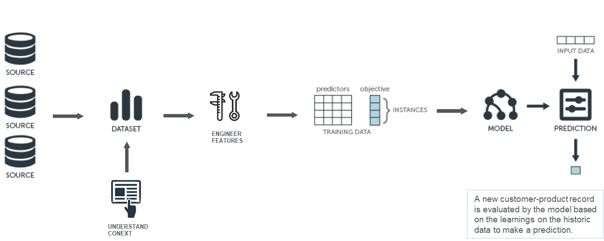
Model development process
An easy to replicate process consolidating the machine learning process into a simple 4 step process.
Model development process
From data ingestion to model application, the process has been developed into a repeatable 4 Step process
DATA ENGINEERING AND LABELLING
BUSINESS CONTEXT
Step 0: Data ingestion
Here you can ingest new data to develop and apply the model using a command line interface
Step 1: Data Engineering
Here you split the ingested data into development and target dataset and apply a churn label to training data
Step 2: Model Development
Here you engineer the features for model development and tune the model
Step 3: Model Application
Here you apply the developed model on target dataset

Slide 33
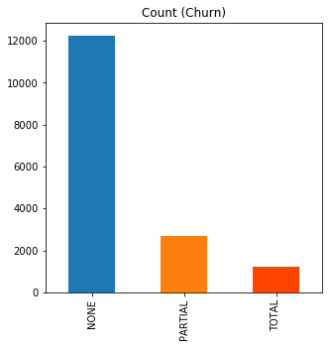
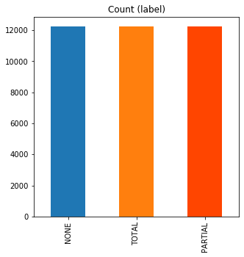
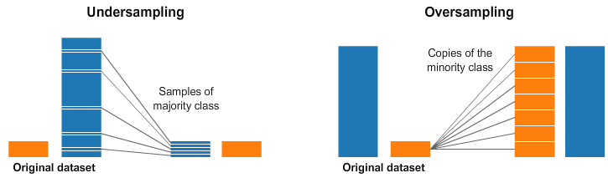
Class imbalance
Ensuring model is not biased due to target class imbalance
Handling class imbalance
Handling class imbalance
Class imbalance in the dependent variable (in our case CHURN_TYPE) occurs when the frequency of one class is significantly higher compared to the class(es).
Here we see that the churn classes (partial and total) have significantly lower frequency (<25%) compared to no churn.
Class imbalance can introduce bias in our model.
We want to give our model equal occurrences of all three classes so that we can take frequency out of the ML model equation.
We apply sampling techniques to alleviate the problem of class imbalance and have a balanced dataset for our model development.

Slide 34
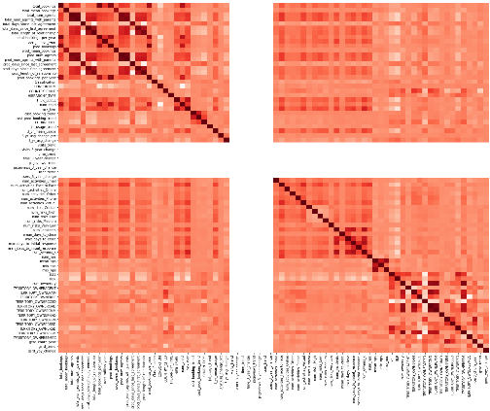
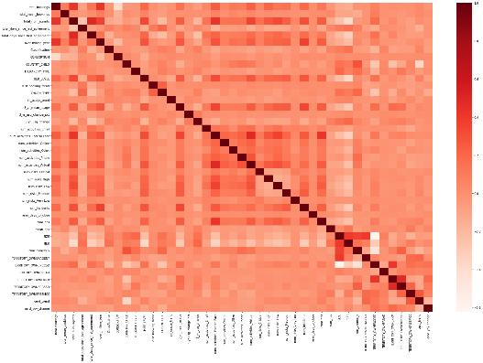
Reducing dimensionality
Handling multicollinearity to avoid overfitting model
Feature correlation matrices
Feature correlation matrices
Multicollinearity refers to predictors that are correlated with other predictors. Multicollinearity occurs when your model includes multiple factors that are correlated not just to your response variable, but also to each other. In other words, it results when you have factors that are a bit redundant.
Curse of dimensionality: refers to the challenges in machine learning when your data has too many features
If we have more features we run the risk of massively overfitting our model this would generally result in terrible out of sample performance.
As the number of features or dimensions grows, the amount of data we need to generalize accurately grows exponentially
High dimension data can cause exponential growth in data and unnecessarily increases storage space and processing time for the particular modelling algorithm
Feature correlation matrix After reducing features

Slide 35
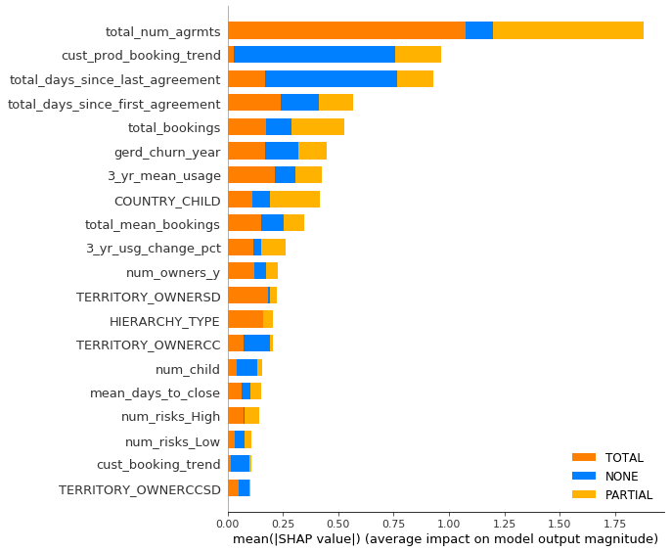
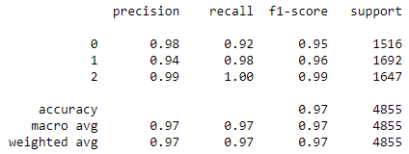
Model results
High number of dimensions (features) give results that look good but probably overfitting the data
Feature importance
High dimension model that is overfitting
As we can see in the diagram on the left, total number of agreements, customer booking trend, recency, total bookings, GERD (economic indicator) and usage data are some of the top predictors of churn.
However given the higher dimensionality and lower sample size the model runs the risk of overfitting as you can see in the below model metrics
We further simplify model by keeping the top predictors

Slide 36
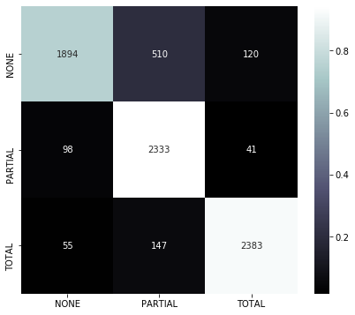
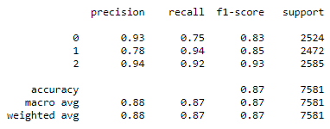
Simplified model results
Simplified dimension model after tuning hyperparameters give a model that is generalised
Simplified model feature importance
Simplified model – a more generalised model
This model has an accuracy of 87% even with just 7 features.
The model is much more simplified and we haven’t lost a significant accuracy and this model is a more generalised without overfitting the data
As we can see in the confusion matrix, the model does well at classifying churn class (TOTAL and PARTIAL)
Where it exhibits small increase error in NONE churn
Small increase in error in classification of total and partial churn
Lower error in classification of total and partial churn

Slide 37
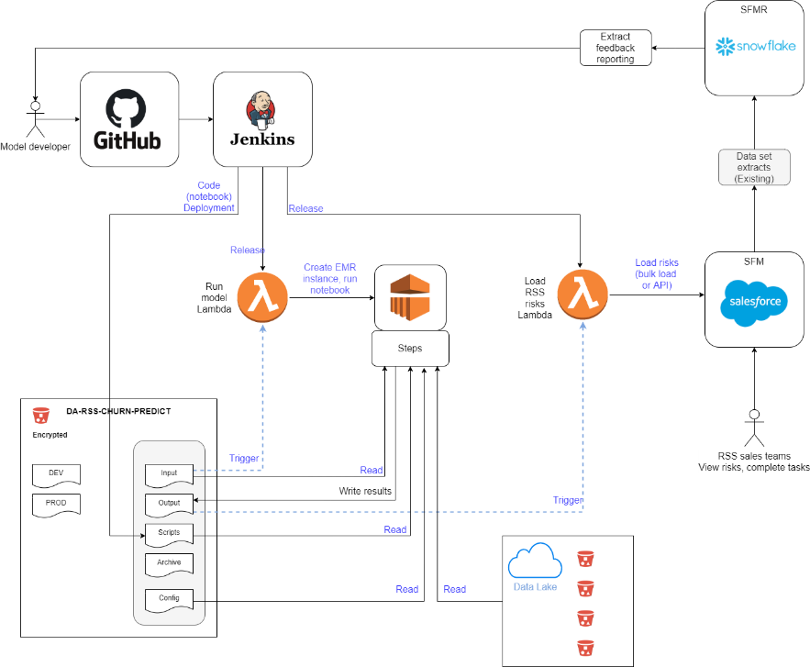
Path to production
Path to production:
Path to production for RSS churn machine learning project was deliberated and defined with Elsevier’s BTS team
A Full productionisation of RSS churn prediction and a MVP (Minimum viable product) option documented on confluence.
A detailed description of the approaches for path to production can be found on the confluence page at:
https://confluence.cbsels.com/display/IN/Machine+learning+PoC+productionization

